Slide 1

Prepoznava defektov na lesnih deskah
Strojni vid
Miha Ožbot
doc. dr. Janez Perš
Ljubljana, marec 2022

Slide 2
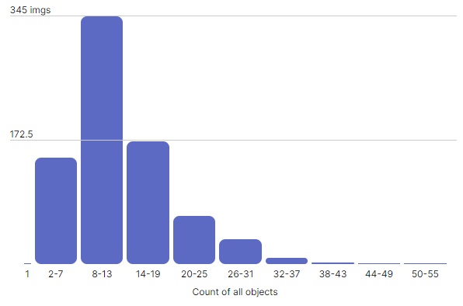
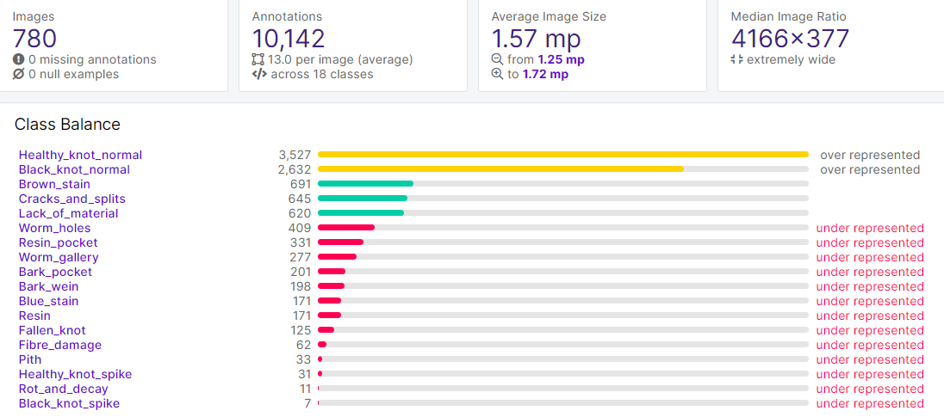
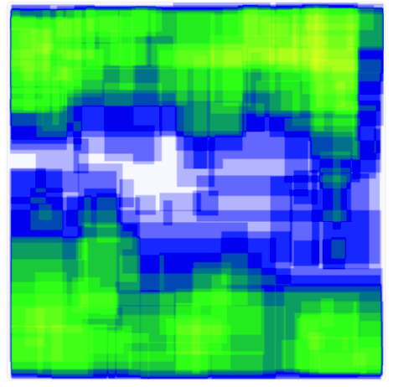
Nabor podatkov - Smreka & bor (naš)

Slide 3
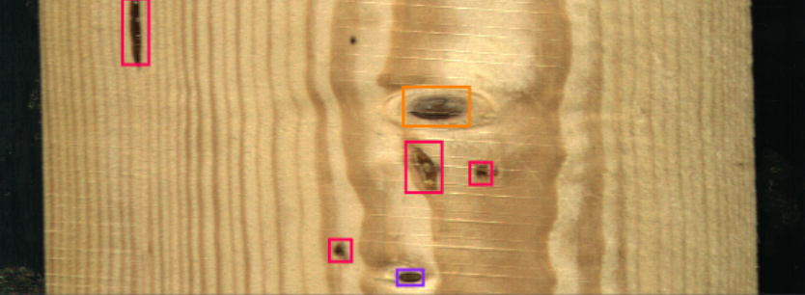
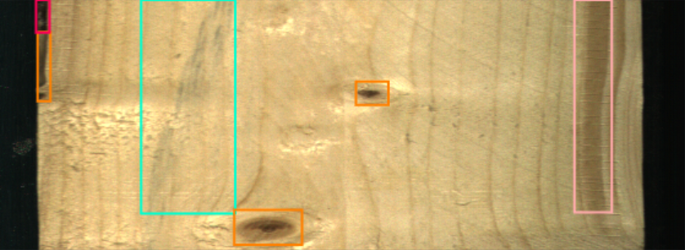
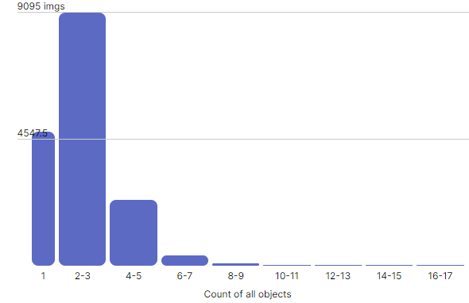
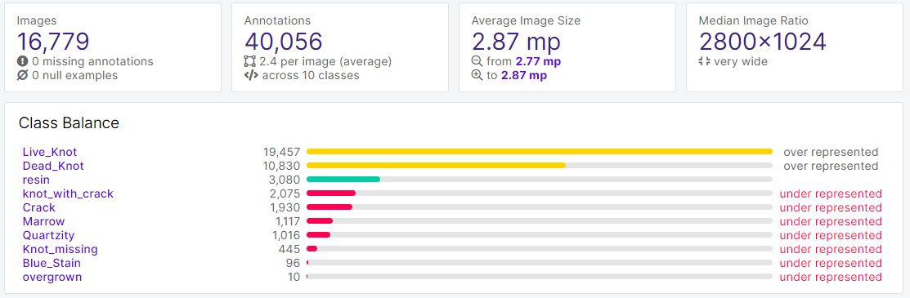
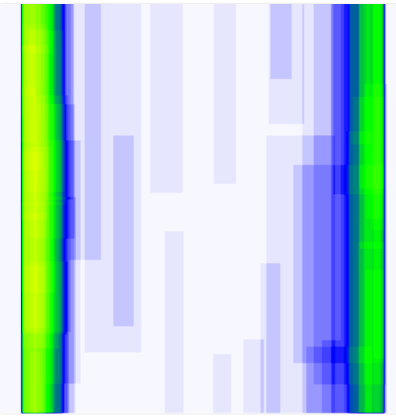
Nabor podatkov - benchmark
[1] Kodytek P, Bodzas A and Bilik P. A large-scale image dataset of wood surface defects for automated vision-based quality control processes [version 1; peer review: 1 approved with reservations]. F1000Research 2021, 10:581 (https://doi.org/10.12688/f1000research.52903.1)

Slide 4
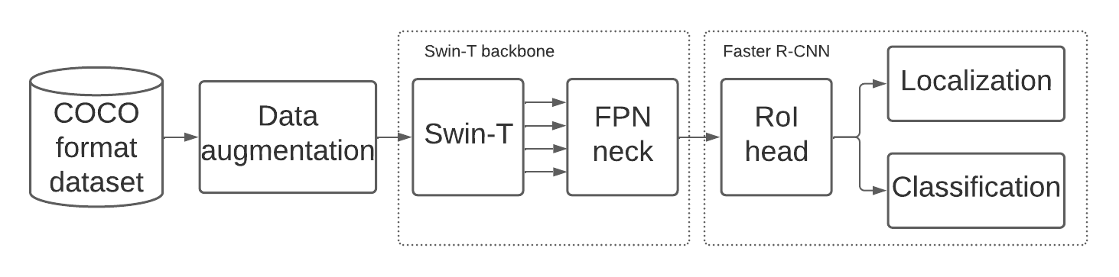
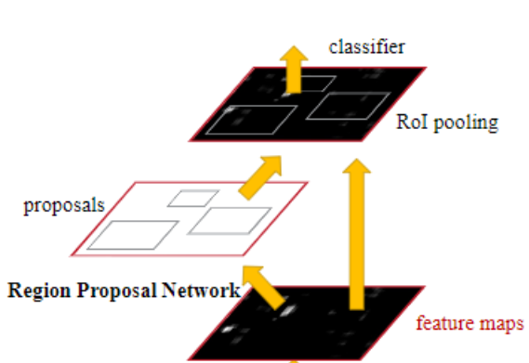
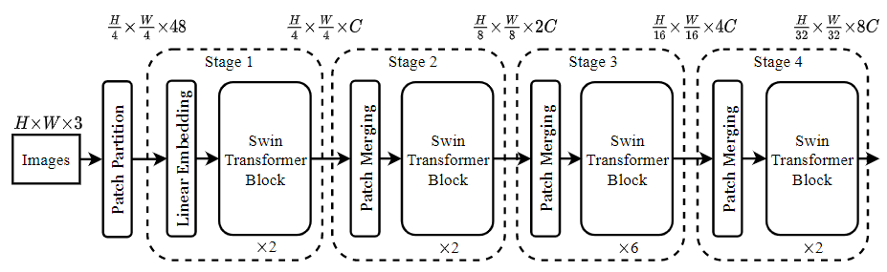
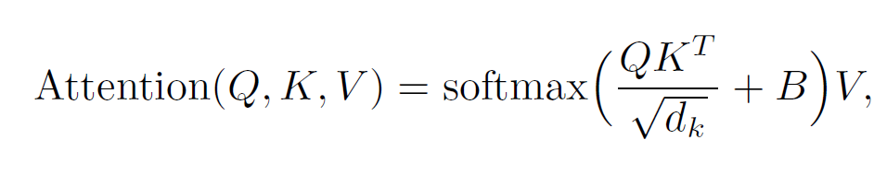
Swin-T & Faster R-CNN
[2] Liu, Z., Lin, Y., Cao, Y., Hu, H., Wei, Y., Zhang, Z., Lin, S., & Guo, B. (2021). Swin Transformer: Hierarchical Vision Transformer using Shifted Windows. http://arxiv.org/abs/2103.14030
[3] Ren, S., He, K., Girshick, R., & Sun, J. (2015). Faster R-CNN: Towards Real-Time Object Detection with Region Proposal Networks. IEEE Transactions on Pattern Analysis and Machine Intelligence, 39(6), 1137–1149. https://doi.org/10.1109/TPAMI.2016.2577031

Slide 5
Eksperimenti
Naključna augmentacija podatkov:
50% verjetnost horizontalnega obrata in 50% vertikalnega obrata,
Izrez od 0% do 20% slike,
striženje (shear) slike med -5° in +5° horizontalno ter -5° in +5° vertikalno,
sprememba svetlosti med -10% in +10%.
Swin-T & Faster R-CNN detekcija objektov za 5 najbolj pogostih defektov iz obeh naborov podatkov: healthy knots, black knots, cracks, resins, in blue stain.
Swin-T & Faster R-CNN detekcija objektov za vse razrede defektov iz obeh naborov podatkov

Slide 6
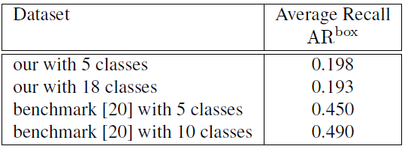
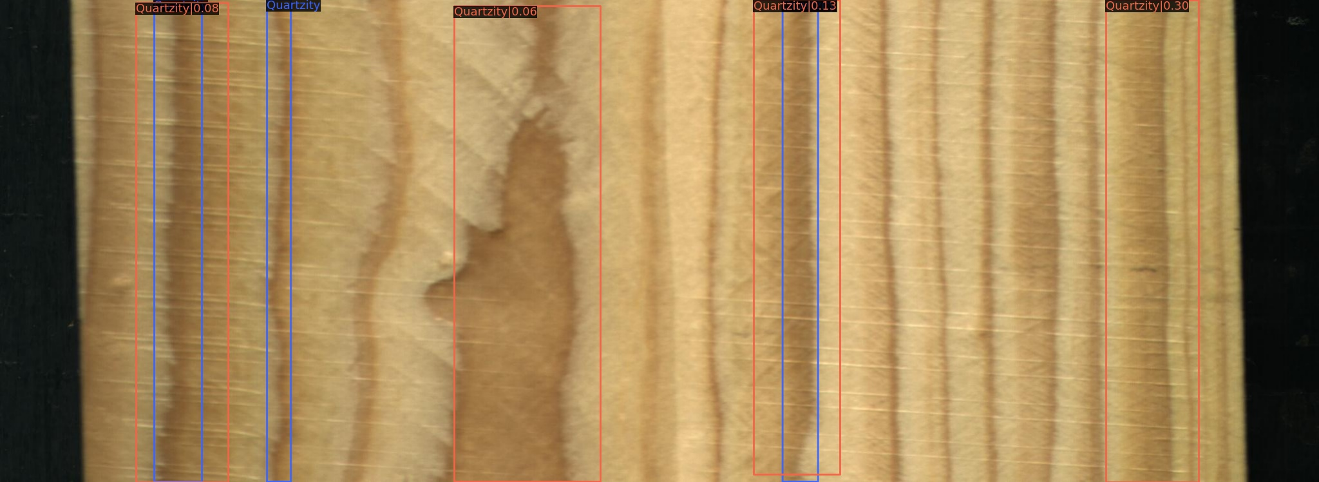
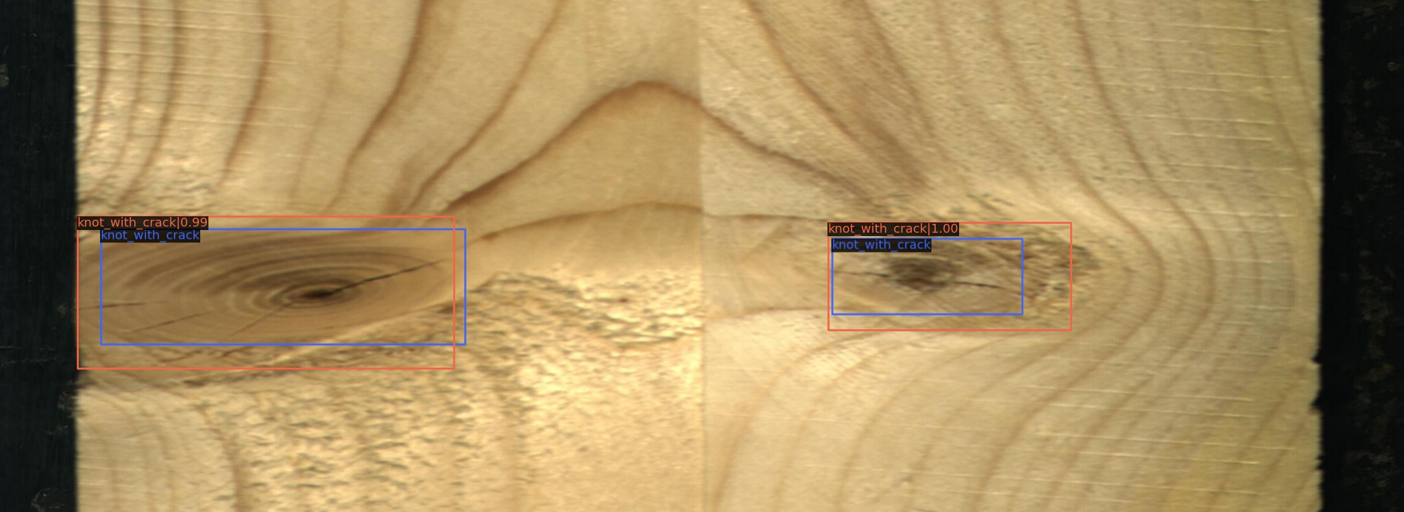
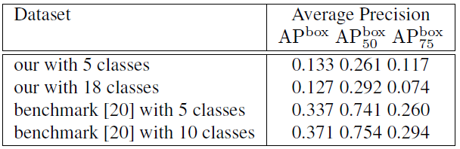
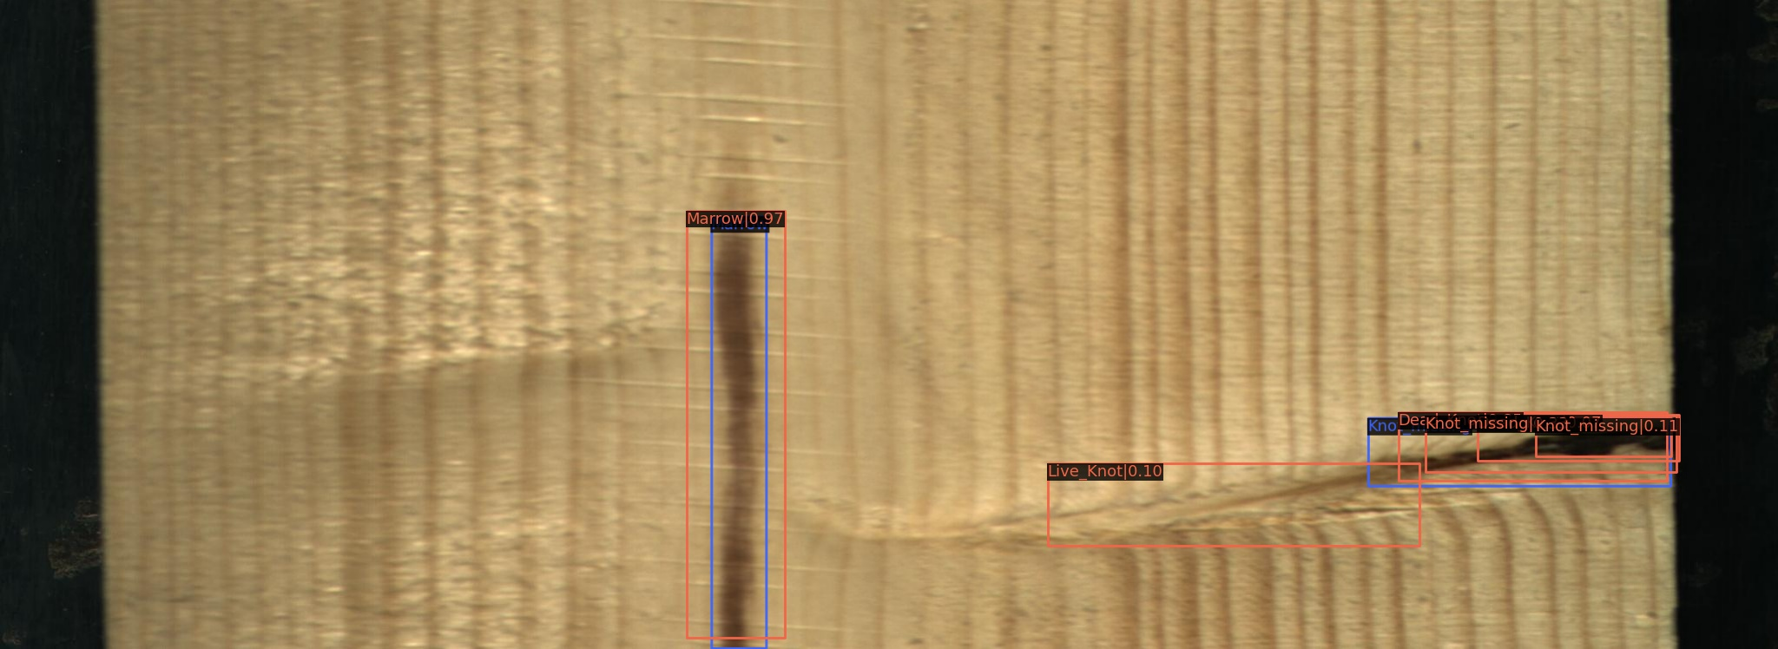
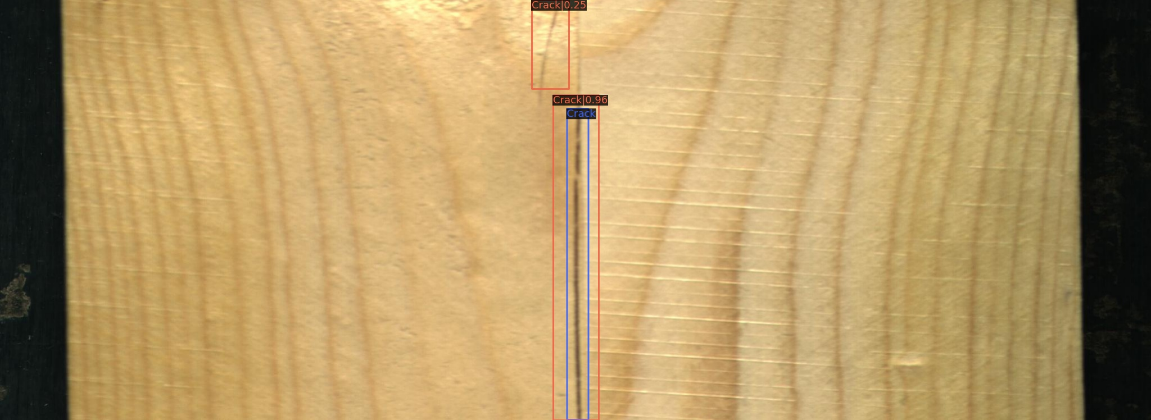
Rezultati

Slide 7
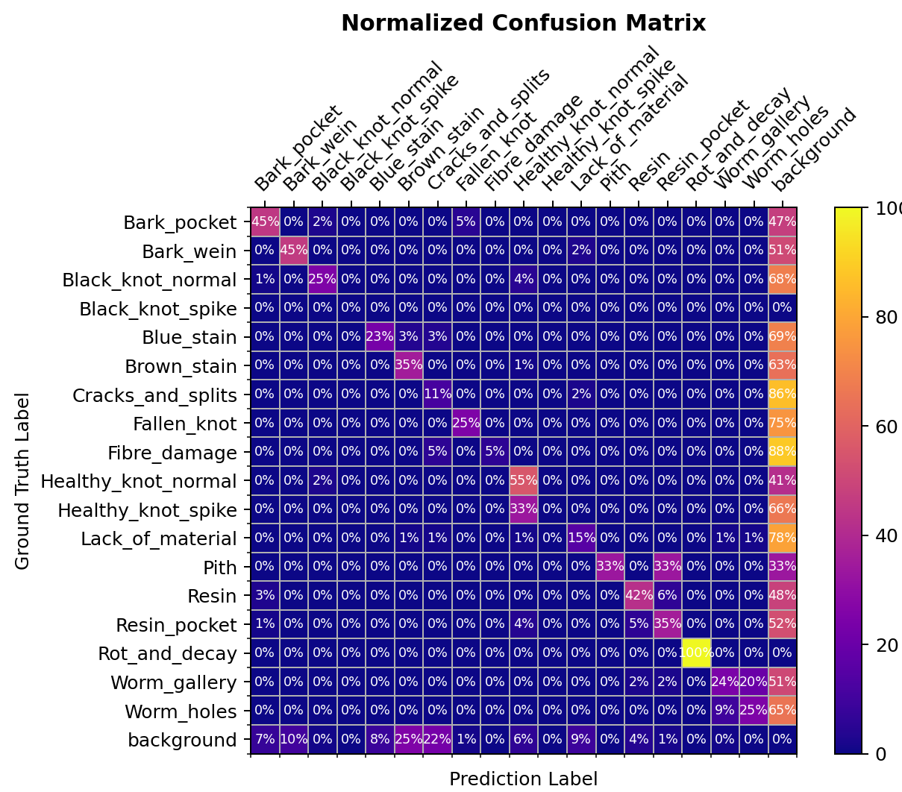
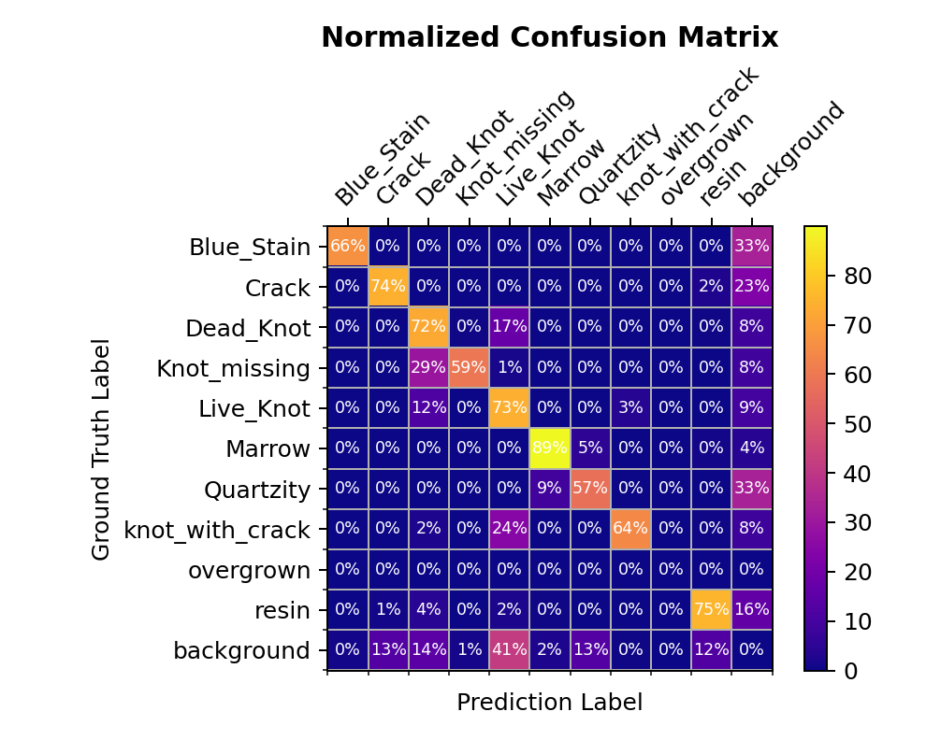


















Rezultati

